Slide 1

Short term Stock Selection and Asset Management
Team:
Aamer Hussain
Ken Ratanvijai
Darren Lee
Minh Hoang Kalka
Capstone Advisor :
Gary Morton
1

Slide 2
Agenda
Problem Statement
Research Purpose
Data
Methodology
Findings
Conclusions
Recommendations

Slide 3
Problem Statement
The aim of this project is to investigate the eﬀectiveness of Reinforcement Learning agents on sequential asset allocation within a financial portfolio.
A ﬁnite set of ﬁnancial assets, such as stocks, Bonds and commodities were selected.
The role of an RL agent is to construct an internal representation (model) of the market, allowing it to determine how to optimally allocate funds of a ﬁnite budget to those assets.
Problem Statement->Research Purpose->Data->Methodology->Findings->Conclusions->Recommendations​

Slide 4
Research Purpose
Our Project Objective is to create a full scale, end-to-end stock analysis tool for private investors or independent financial advisors that is simple and customizable to each investor
Portfolio optimization
Asset Screening and selection
Monte Carlo Simulations of expected returns
Investor’s Risk Tolerance Survey
Stock selection and Portfolio optimization
Backtesting
Problem Statement->Research Purpose->Data->Methodology->Findings->Conclusions->Recommendations​

Slide 5
Data & Feature Engineering
NLP
Google Search Trends, Investment News Sentiment Analysis
Time Series
Trend, Seasonality
Technical Indicators
Moving Average Convergence Divergence (MACD), Relative Strength Index (RSI)
Other
Trading Volume, fundamentals, asset class type, Turbulence Index
Data Profile
503 Stock profile from S&P 500
296,536 observations (daily 1-year historical data)
5,685 missing values
10 Technical indicators (EMA, MACD, L14, etc)
28 Indirect features (Google trend, commodities, bitcoin, etc)
6 direct features (Price , volume, trend, etc)
Problem Statement->Research Purpose->Data->Methodology->Findings->Conclusions->Recommendations​

Slide 6
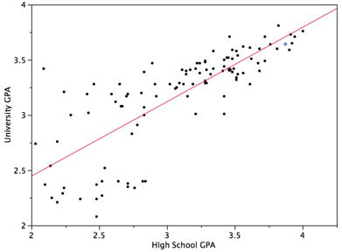
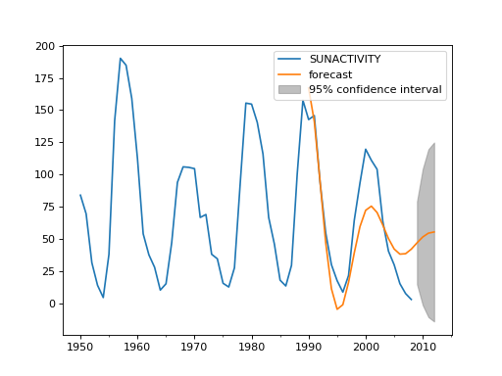
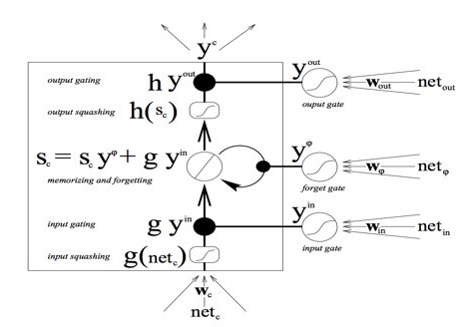
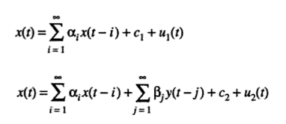
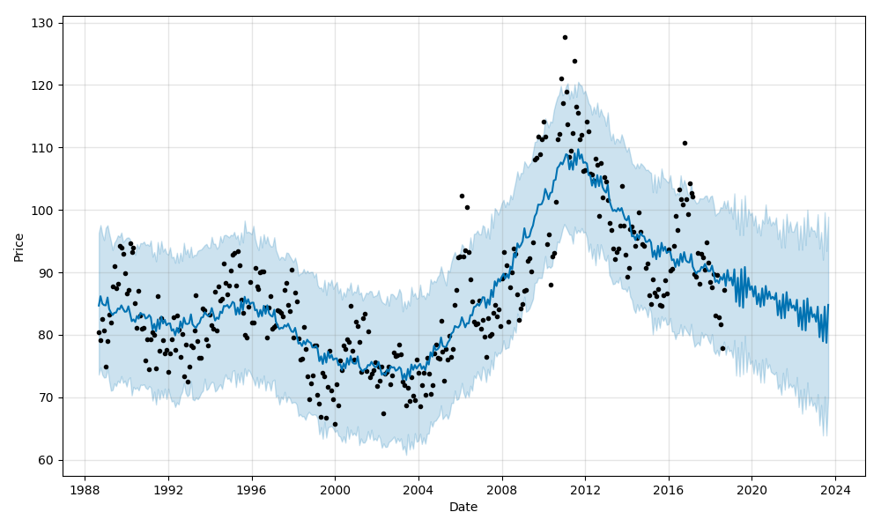
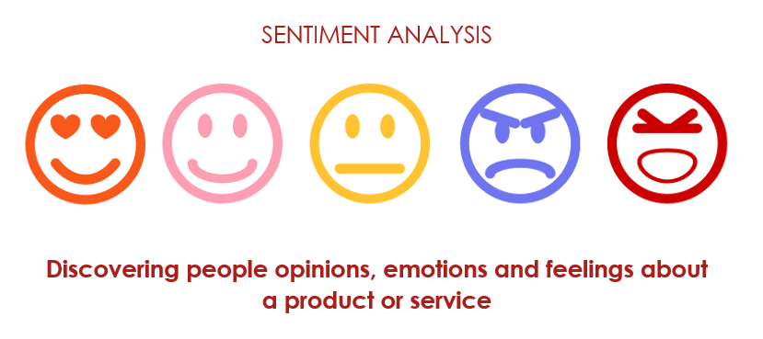
Methodology – Times Series & LSTM
Base model
Deep learning model
Regression
ARIMA
Multivariate LSTM
Granger Causality
fbProphet
Sentimental Analysis
Problem Statement->Research Purpose->Data->Methodology->Findings->Conclusions->Recommendations​

Slide 7
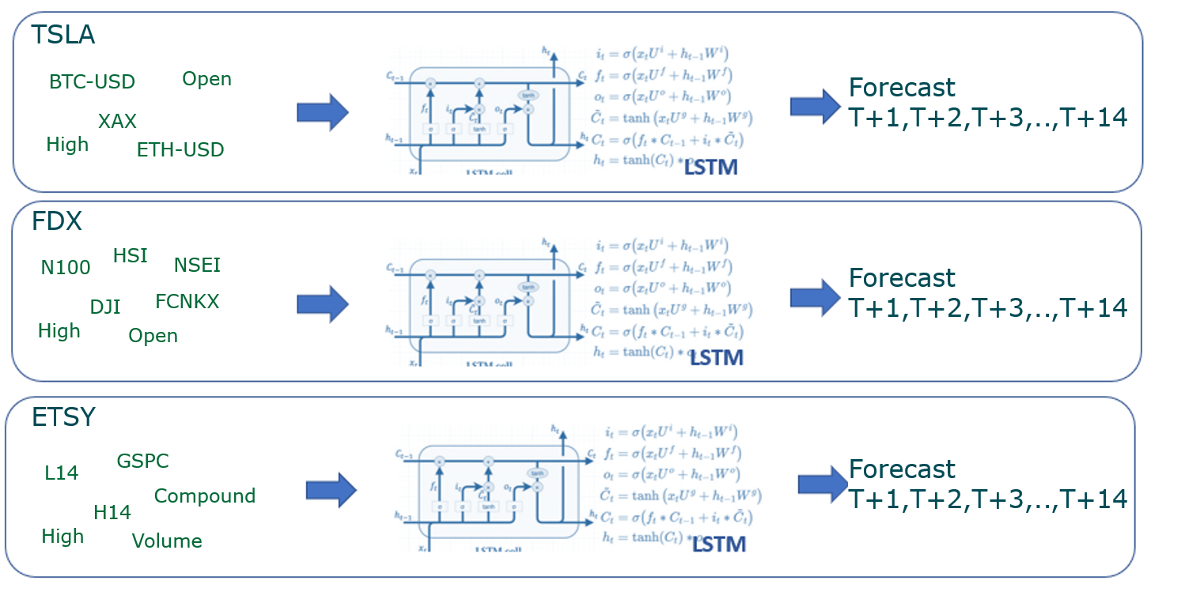
Methodology – Times Series & LSTM
Sample importance features selected from Granger causality for each stock
Forecast T+1,T+2,T+3,…,T+10
DIS
Forecast T+1,T+2,T+3,…,T+10
Forecast T+1,T+2,T+3,…,T+10
Problem Statement->Research Purpose->Data->Methodology->Findings->Conclusions->Recommendations​

Slide 8
Portfolio Data
Commodities
Total portfolio capital : $1 Million
Stocks
Bonds
Name | Ticker
Apple | AAPL
Microsoft | MSFT
Amazon | AMZN
Google | GOOG
Tesla | TSLA
Dataset : Time series data for all the 9 assets from 2014-01-01 to the present data
Data source : Webscraping from yfinance website
Name | Ticker
HCA healthcare | HCA
Vortex | VRTX
Name | Ticker
Bitcoin | BTC-USD
Palladium | PA=F
Training data : 2014-01-01 to 2018-12-01
Test data : 2019-01-01 to the present day
Training data rows : 1652
Problem Statement->Research Purpose->Data->Methodology->Findings->Conclusions->Recommendations​

Slide 9
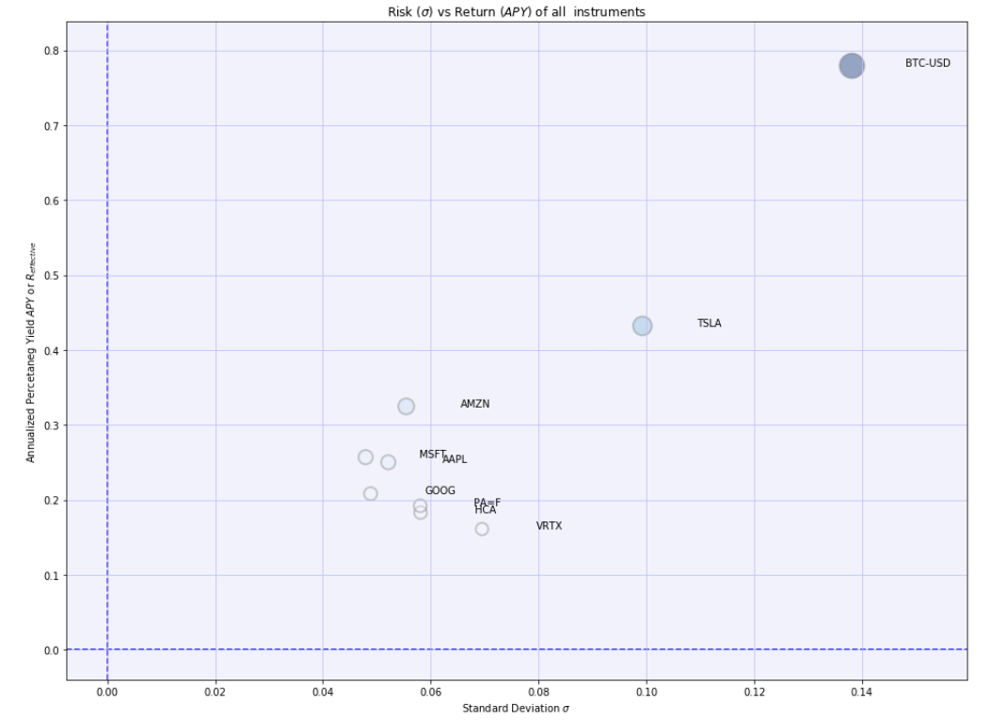
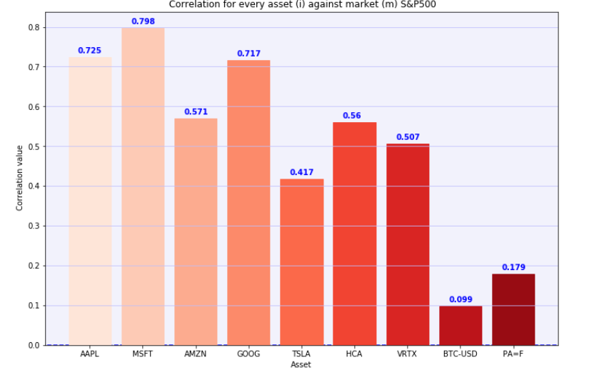
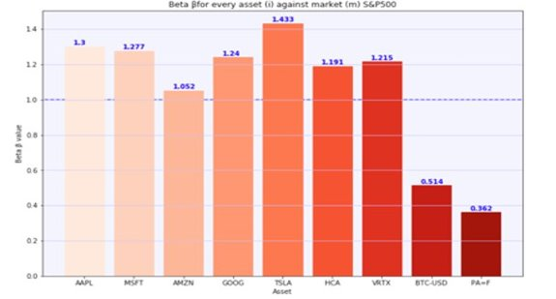
Descriptive Analyses
Correlation of all the assets against S&P 500
Beta(variance) of each asset against S&P 500
Risk vs return for all the assets
Problem Statement->Research Purpose->Data->Methodology->Findings->Conclusions->Recommendations​

Slide 10
Why Reinforcement learning for Portfolio optimization ?
RL helps us in tackling asset allocation not just as a single-step optimization problem , but as continuous control of the weights in a financial asset portfolio with the delayed reward strategy​
In a data-driven world , It enables us move to from optimal asset allocation of weights to optimal control territory within the market simulated environment .​
They don’t do the predictions and then try to implicitly learn the structure of the financial market ​
They directly learn the policy of changing the weights dynamically in the continuously changing market​
Problem Statement->Research Purpose->Data->Methodology->Findings->Conclusions->Recommendations​

Slide 11
Methodology – DQN Reinforcement learning
Each financial asset in the portfolio is represented by a local agent​
In each local agent, a specialized deep Q-learning technique to define a global reward function used to dynamically define the action taken by each local agent​
Hence, actions are weighted and applied to each asset in the portfolio​
Deep reinforcement learning is used as a dynamic decision-making systems in portfolio management, where an agent has to continuously reallocate an amount of fund into a number of different financial assets with the final goal of maximizing return and minimizing risk
Reinforcement learning can be understood using the concepts of agents, environments, states, actions and rewards
The Modelling framework is composed by two elements:
a set of local agents that learn assets behaviours
a global agent that describes the global reward function​
Auto encoder agent
Maximal returns agent
Hierarchical risk parity agent
PCA agent
Max sharpe agent
Min variance agent
Holt winters
Max decorrelation
Problem Statement->Research Purpose->Data->Methodology->Findings->Conclusions->Recommendations​

Slide 12
Assumptions – Reinforcement learning
Zero slippage :The liquidity of all market assets is high enough that , each trade can be carried out immediately at the last price when a order is placed.
Zero market impact : The capital invested by the trading agent is so insignificant that it has zero influence on the market
Problem Statement->Research Purpose->Data->Methodology->Findings->Conclusions->Recommendations​

Slide 13
Hyperparameter tuning
window_size = 180
episode_count= 100
batch_size = 32
rebalance_period = 90
dropout=0.25
Activation = Elu
optimizer=‘Adam’
loss=‘MSE’
Layers = 5
Epochs = 100
alpha = 0.5
gamma = 0.95
epsilon = 1.0
epsilon_min = 0.01
epsilon_decay = 0.99
Problem Statement->Research Purpose->Data->Methodology->Findings->Conclusions->Recommendations​

Slide 14
Findings – Time Series
The 5 highest growth stock base on growth prediction
The 5 highest growth stock base on growth prediction that price/std over 102 (S&P500 std)
 |  |  | Adj Close | Predict Growth |  | Actual Growth
Stock | Name | Industry | 31-Mar | 15-Apr | Growth | 15-Apr | Growth
TSLA | Tesla, Inc. | Auto Manufacturers | 667.93 | 817.08 | 22% | 738.85 | 11%
ETSY | Etsy, Inc. | Internet Retail | 201.67 | 240.23 | 19% | 219.29 | 9%
DIS | Walt Disney | Entertainment | 184.52 | 217.31 | 18% | 185.93 | 1%
TER | Teradyne, Inc. | Semiconductor | 121.68 | 142.35 | 17% | 131.19 | 8%
FCX | Freeport-McMoRan Inc. | Basic Materials | 32.93 | 38.48 | 17% | 37.83 | 15%
 |  |  | Adj Close | Predict Growth |  | Actual Growth
Stock | Name | Industry | 31-Mar | 15-Apr | Growth | 15-Apr | Growth
PKI | PerkinElmer, Inc. | Healthcare | 128.29 | 132.97 | 4% | 134.63 | 5%
FITB | Fifth Third Bancorp | Banks | 37.45 | 38.72 | 3% | 38.03 | 2%
J | Jacobs Engineering | Engineering | 129.27 | 133.28 | 3% | 133.91 | 4%
TRV | Travelers Companies | Insurance | 150.40 | 154.81 | 3% | 154.36 | 3%
CTSH | Cognizant | IT | 78.12 | 80.40 | 3% | 79.77 | 2%
High growth portfolio | Growth
Portfolio Actual Growth | 8.5629%
S&P 500 Benchmark Growth | 4.9719%
standard deviation under S&P 500 portfolio | Growth
Portfolio Actual Growth | 2.9650%
S&P 500 Benchmark Growth | 4.9719%
Problem Statement->Research Purpose->Data->Methodology->Findings->Conclusions->Recommendations​

Slide 15
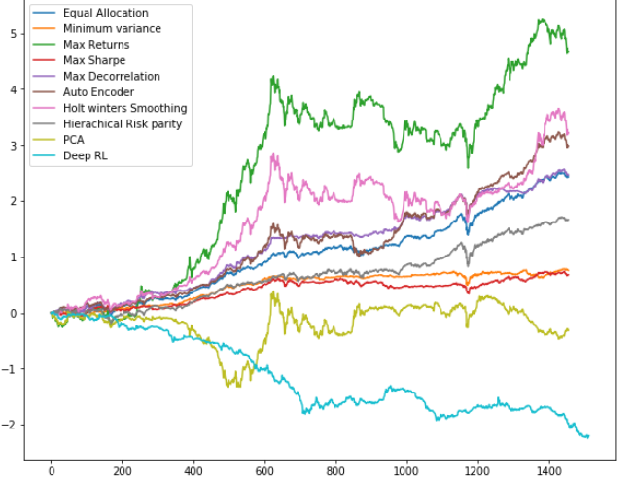
Portfolio Findings and Performance from the DQN Reinforcement learning
 | Benchmark | Minimal variance | Maximal returns | Maximal sharpe | Max decorrelation | PCA | HRP | Auto encoder | Holt winters ex smoothing | RL
Mean returns | 0.0018 | 0.0007 | 0.0039 | 0.0007 | 0.0014 | -0.0019 | 0.0015 | 0.0028 | 0.0027 | 0.0026
Volatility | 0.0148 | 0.0086 | 0.0481 | 0.0089 | 0.0135 | 0.0314 | 0.0157 | 0.025 | 0.0354 | 0.0214
Sharpe ratio | 1.9357 | 1.383 | 1.3004 | 1.1914 | 1.6146 | -0.9322 | 1.4907 | 1.8081 | 1.1868 | 1.9142
Alpha | -0.0 | 0.0002 | 0.0008 | 0.0 | 0.0003 | -0.0013 | -0.0004 | 0.0007 | 0.0003 | 0.0009
Beta | 1.0 | 0.3003 | 1.6181 | 0.3337 | 0.5461 | -0.2714 | 0.9878 | 1.1089 | 1.2043 | 0.9455
Problem Statement->Research Purpose->Data->Methodology->Findings->Conclusions->Recommendations​

Slide 16
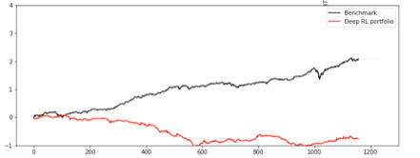
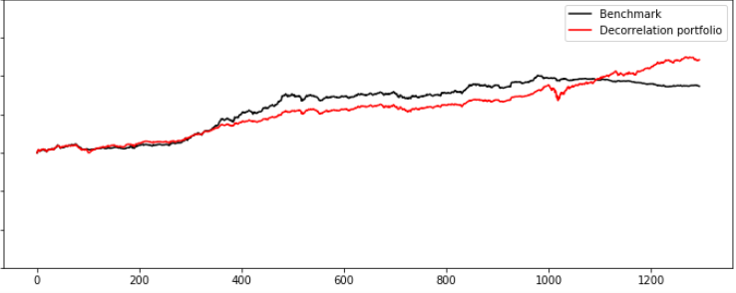
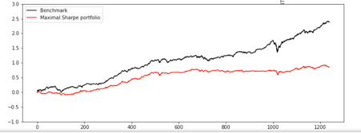
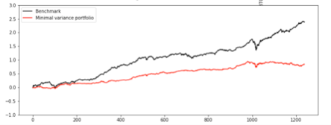
Findings – DQN Reinforcement Learning
Problem Statement->Research Purpose->Data->Methodology->Findings->Conclusions->Recommendations​

Slide 17
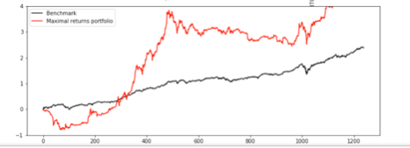
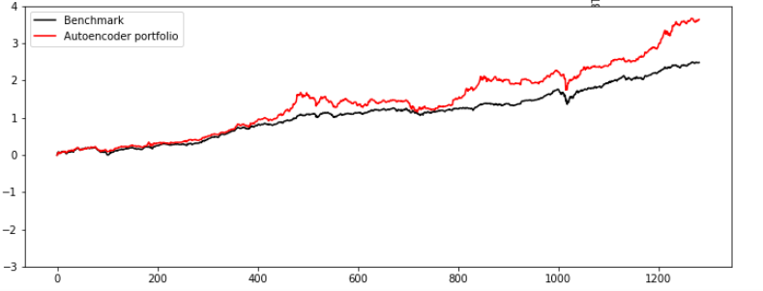
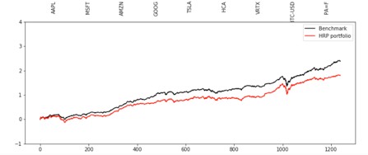
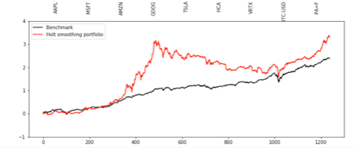
Findings – DQN Reinforcement Learning
Problem Statement->Research Purpose->Data->Methodology->Findings->Conclusions->Recommendations​

Slide 18
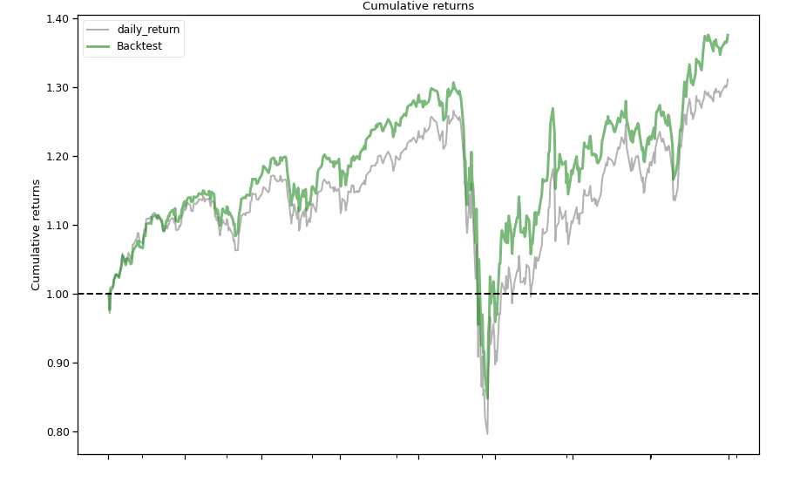
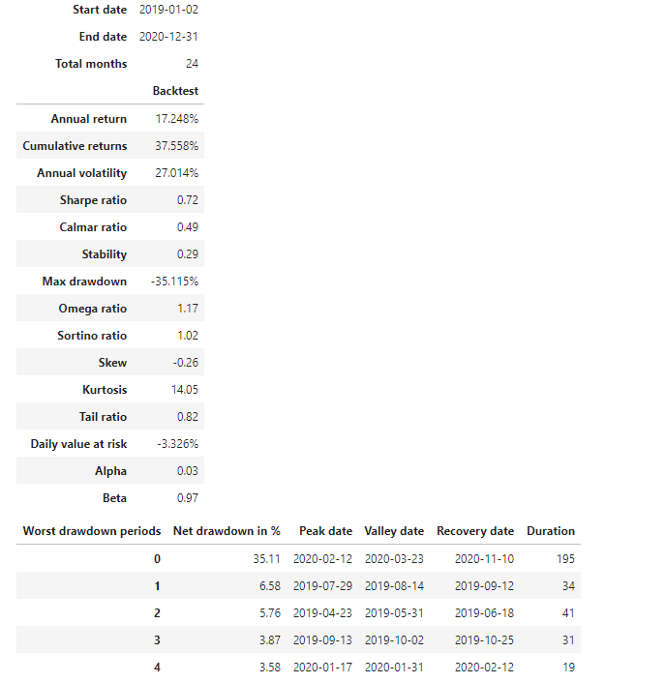
Back testing (A2C Model)/ cross validations​
Problem Statement->Research Purpose->Data->Methodology->Findings->Conclusions->Recommendations​
Notes:
Overall, this Reinforcement Learning model beats the market with higher return than the cumulative Dow Jones index data. Higher return leads to higher. I used different asset compare what Aamer using. My model will be more dynamics than Aamer RL model just because I'm adding turbulance of Financial Crisi 2007-2008.

Slide 19
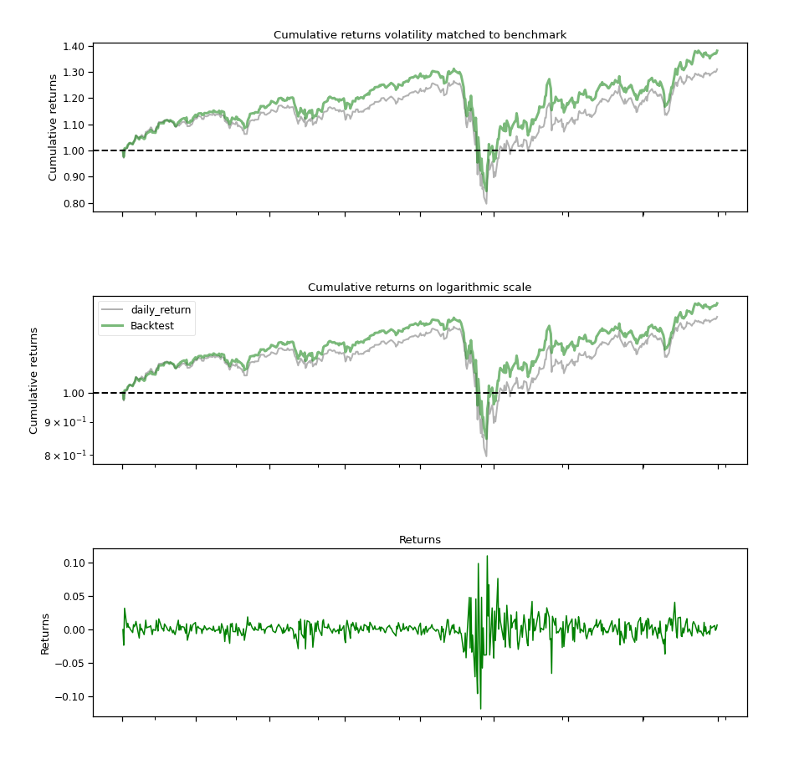
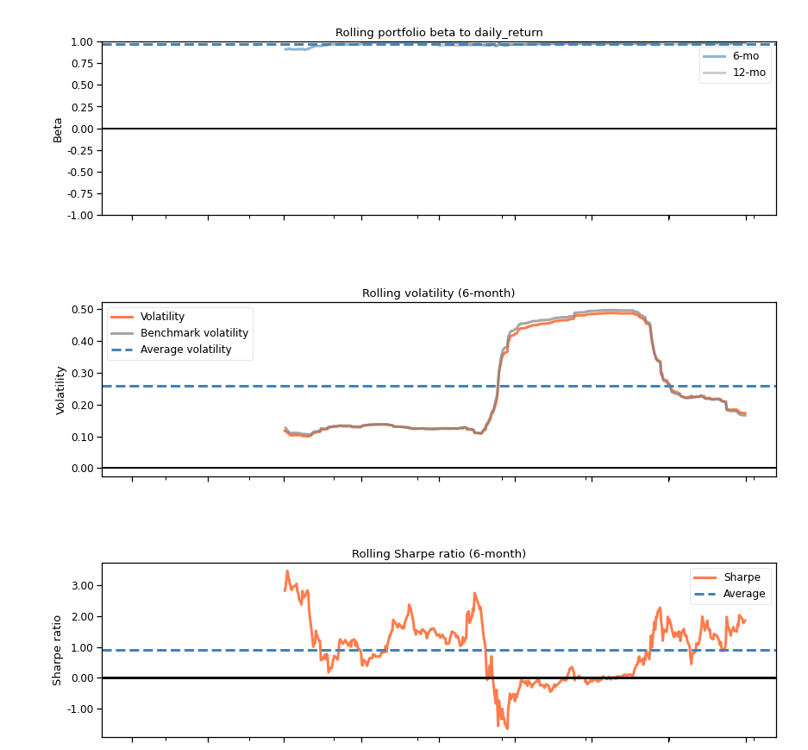
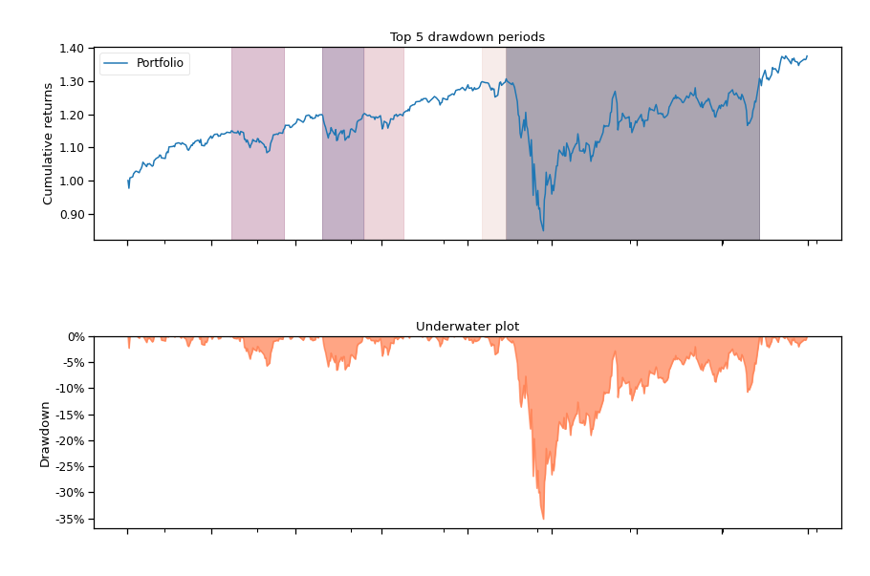
Back testing (A2C Model)/ cross validations​
Problem Statement->Research Purpose->Data->Methodology->Findings->Conclusions->Recommendations​
Notes:
The Sharpe ratio less than 1 but close to 1, meaning the Expected Return Value of the excess of asset return over benchmark return is higher respectively to a given annual volatility. Rolling volatility in 6-month period has a jump then drop in the beginning of Covid lockdown period. The same as the Max Drawdown, there are a tremendous drop at the same period.

Slide 20
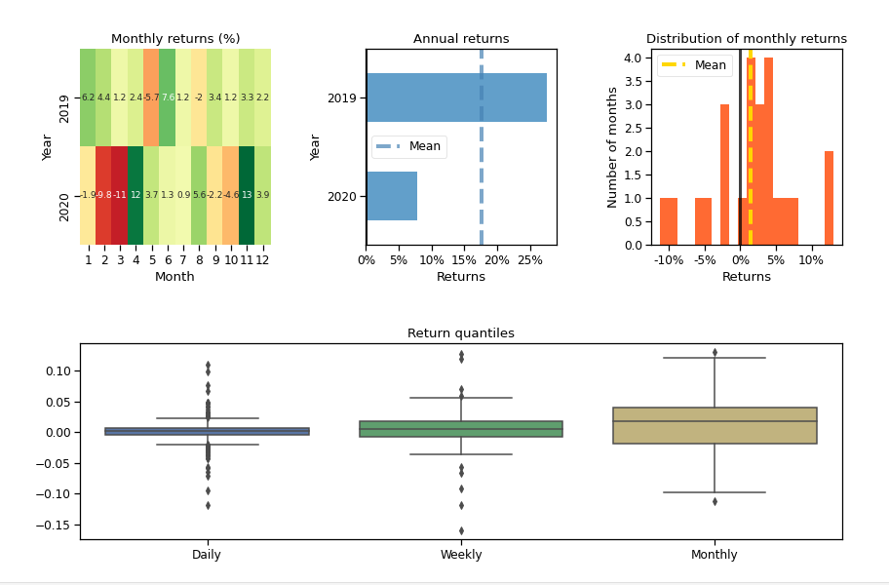
Findings – Deep Reinforcement Learning (A2C Model)
When we look at the monthly return, we can see some red month in 2020 such as from February and March. Interestingly, the highest return is during the election times in November. Annual return of 2019 is higher than 2020. The monthly distribution attributes Gaussian distribution. In the box plot perspective, the amounts of outliers decrease respectively in daily, weekly and monthly.
Problem Statement->Research Purpose->Data->Methodology->Findings->Conclusions->Recommendations​

Slide 21
Challenges and Limitations – Deep Reinforcement Learning (A2C Model)
Limited in Risk Tolerance adjustments
Portfolio Weight Constraints
Limited in using timeframes.
Trading bonds with turbulence doesn’t affect Max Drawdown
Limited in different Index data
Alpha Decay
Problem Statement->Research Purpose->Data->Methodology->Findings->Conclusions->Recommendations​

Slide 22
Summary and limitations – DQN Model
In the tradeoff of exploration vs exploitation, it inclined more towards exploitation instead of further exploration
It might be worth including the principles or implementing the strategies from mathematically more grounded models like stochastic portfolio theory
We can also explore other strategies like: Policy based strategy where the RL agent learns a particular policy by using the reward signal to guide the adaptation instead of using the value-based policy like epsilon greedy search
Problem Statement->Research Purpose->Data->Methodology->Findings->Conclusions->Recommendations​

Slide 23
Conclusions
With this project , we were able to adapt the ideas underlying the success of Deep Q learning to the continuous action domain .
Our algorithms were able to achieve at least 4-fold returns in 120 days using our best performing RL agent of maximal returns with 28% less risk .
Problem Statement->Research Purpose->Data->Methodology->Findings->Conclusions->Recommendations​

Slide 24
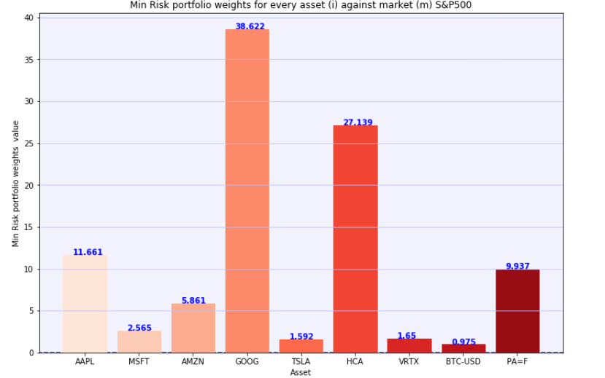
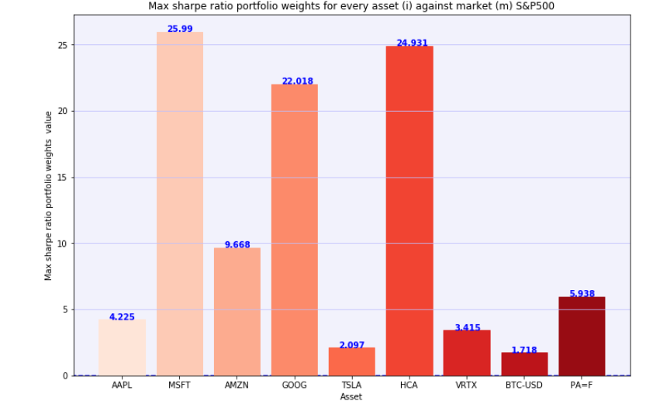
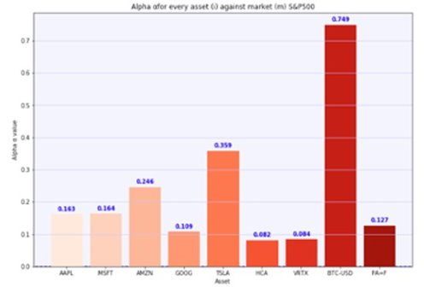
Business Recommendations
Min Risk Portfolios
Monte Carlo Simulations
Max Sharpe Ratio Portfolio
Max Returns Portfolio
Problem Statement->Research Purpose->Data->Methodology->Findings->Conclusions->Recommendations​

Slide 25
Thank you

Slide 26
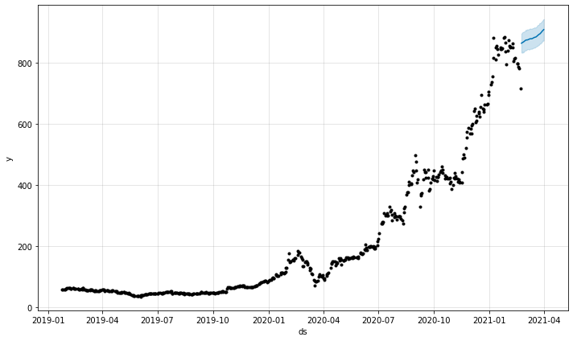
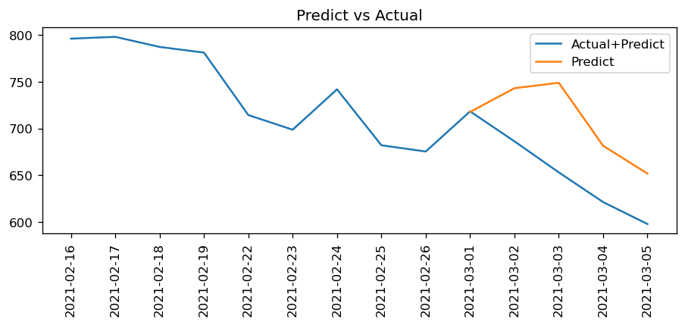
Findings – Time Series
Stock | Models | Metrics (RMSE) | RMSE / Price
TSLA (TESLA) | Auto.ARIMA(5 yr*) | 73.6 | 0.1102
TSLA (TESLA) | Auto.ARIMA(1 yr**) | 62.9 | 0.0942
TSLA (TESLA) | fbProphet(1 yr**) | 144.5 | 0.2163
TSLA (TESLA) | Multivariate Multistep LSTM(5 yr**) | 27.2 | 0.0407
TSLA (TESLA) | Multivariate Multistep LSTM(1 yr**) | 15.7 | 0.0235
Note: 5yr* = (Jan 2016 – Dec 2020). Adj Close price is 705.67
1yr** = (Jan 2020 – Mar 2021). Adj Close price is 667.9

